Slide 1
Air quality index prediction using Machine learning
CEC Certification Course on Applied Data Analytics : A Practical Approach
Guided by : Dr. Mridu Sahu (Assistant Professor)NIT Raipur
Presented by : Rashmi Dongre

Slide 2

TABLE OF CONTENT:
Introduction
Abstract
Literature review
Dataset
Model implementations
Result
Conclusion

Slide 3
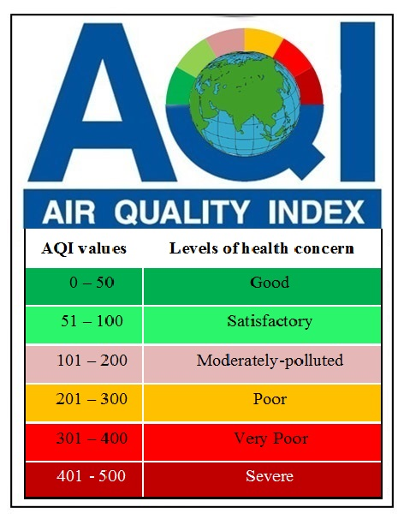
Introduction:
AQI is an overall scheme that transforms individual air pollutant (e.g. SO2, CO, PM10) levels into a single number, which is a simple and lucid description of air quality for the citizens.
AQI relates to health impacts and citizens can avoid the unnecessary exposure to air pollutants;
AQI indicates compliance with National Air Quality Standards;
AQI prompts local authorities to take quick actions to improve air quality;
AQI guides policy makers to take broad decisions; and
AQI encourages citizens to participate in air quality management.

Slide 4
Parameter that affect AQI:
Particulate Matter (PM10 & PM2.5):
A mixture of particles with liquid droplets in the air forms particulate matter.
PM10 are size of 10 microns, PM2.5 are ultra-fine particles having size of less than 2.5 microns
Particulate Matter is released from constructions, smoking, cleanings, renovations, demolitions, constructions, natural hazards such as earthquakes, volcanic eruptions, and emissions from industries such as brick kilns, paper & pulp, etc.
Carbon Monoxide (CO):
It is a colorless gas, released from automobile emissions, fires, industrial processes, gas stoves, kitchen chimneys, generators, wood-burning smoking, etc. into the atmosphere.
Ozone (O3):
The ground ozone is very harmful to human beings and the environment.
It is released from industries, automobile emissions, gasoline vapors, solvents, chemicals, and electronic devices
Nitrogen Dioxide (NOx):
Nitrogen dioxide is a known highly reactive gas present in the atmosphere.
It is released into the environment from automobile emissions, generation of electricity, burning of fuel, combustion of fossil fuel, and different industrial processes.
Sulphur Dioxide (SO2):
The gas is acidic & corrosive in nature and can react in the atmosphere with other compounds to form sulfuric acid and other oxides of sulfur.
Emissions from automobiles, industries, combustion of fossil fuel, generation of electricity, etc. are reasons for the entry of sulfur dioxide into the atmosphere.
Ammonia (NH3):
Ammonia is a colorless, reactive, and soluble alkaline gas with a strong pungent odor and is only used by the Indian government as a parameter of AQI.
The major sources of ammonia are agricultural activities, animal husbandry, fertilizers, various industrial processes, emissions from automobiles, volatilization from oceans and soil, etc.

Slide 5
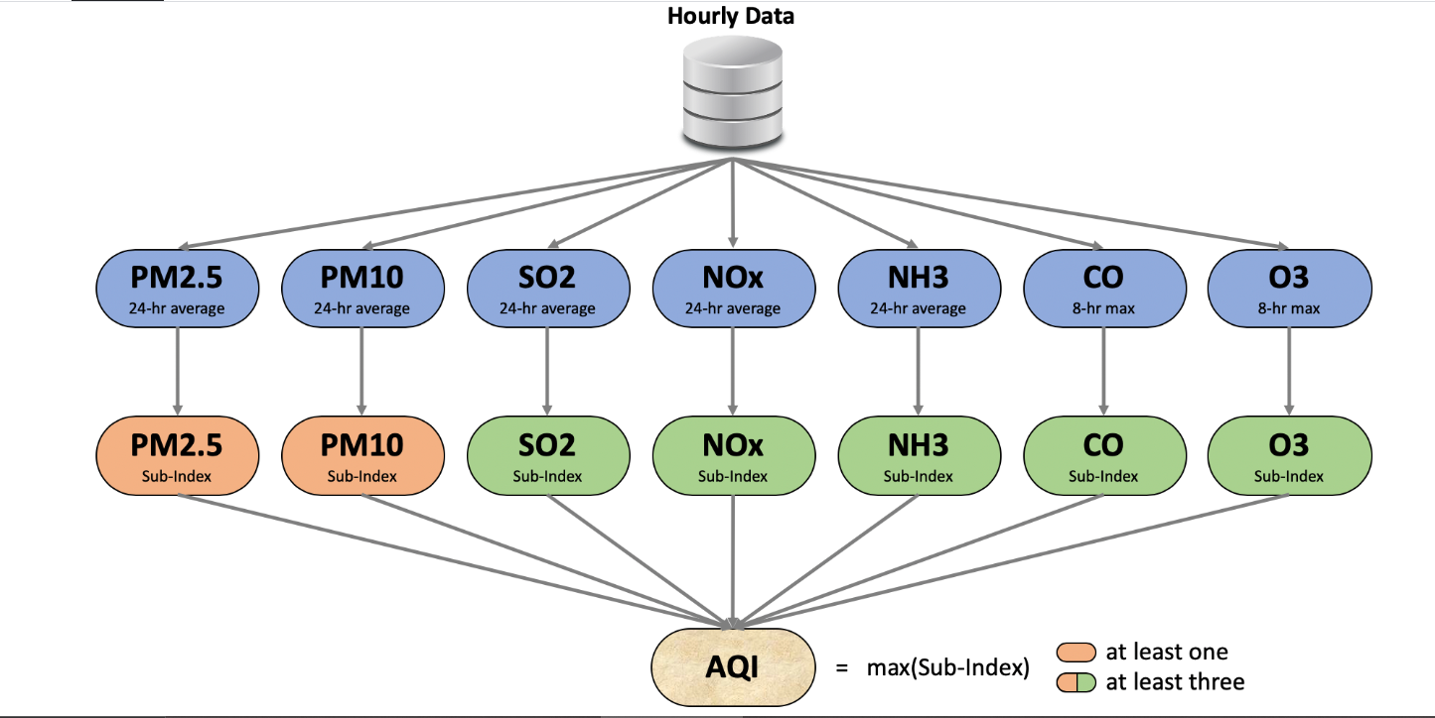
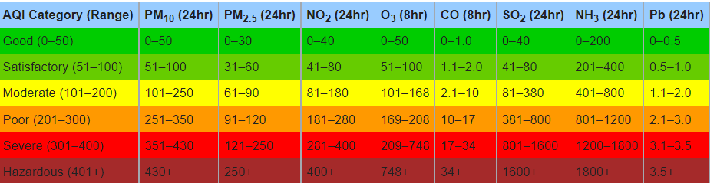
HOW AIR QUALITY INDEX IS CALCULTED
The AQI calculation uses 7 measures: PM2.5, PM10, SO2, NOx, NH3, CO and O3.
For PM2.5, PM10, SO2, NOx and NH3 the average value in last 24-hrs is used with the condition of having at least 16 values.
For CO and O3 the maximum value in last 8-hrs is used.
Each measure is converted into a Sub-Index based on pre-defined groups.
Sometimes measures are not available due to lack of measuring or lack of required data points.
Final AQI is the maximum Sub-Index with the condition that at least one of PM2.5 and PM10 should be available and at least three out of the seven should be available.

Slide 6
Literature review
Paper Title | Authors | Methodology
Using Machine Learning to Predict Air Quality Index in New Delhi | 1)Samayan Bhattacharya, 2)Sk Shahnawaz Department of Computer Science and Engineering Jadavpur University | They have used the support vector regression (SVR) model to forecast the level of various pollutants And the air quality index using the CPCB data , they have test the various kernels performance And observed that a radial basis function (RBF)Kernel produced the best results with SVR and they had also performed the feature selection but they have Obtained that the have all pollutants giving the best result and they have achieve the accuracy of 93.4%
Analysis of classification and clustering techniques for ambient AQI using machine learning algorithms | Dr.Senthil Kumar R Dr.Anidha Arulanandham Dr.Suresh Arumugam Dr. Dinesh G Dr.Thirukkumaran R Dr.Subashmoorthy R Department of Computer Science and Engineering New Horizon College of Engineering Marathalli, Bengaluru, | A detailed analysis was performed using various classification algorithms such as the Naive Bayesian model and Bayes network model, the regression models such as support vector regression, logistic regression, and multilayer perceptron model, the instance-based models such as KNN and locally weighted regression, the ensemble models such as Bagging and Boosting model and Tree-based models such as J48 and Random forest are used. From the clustering technique, k-means clustering and EM clustering were used for the analysis
Research on Machine Learning Prediction of Air Quality Index Based on SPSS | Limei Ma 1. College of Information Technology Hebei Normal University Shijiazhuang, China 2. Key Laboratory of Network and Information Security in Hebei Province, Shijiazhuang, China 3. School of Information Studies, Dominican University River Forest, In USA Yijun Gao School of Information Studies Dominican University River Forest, In USA | SPSS is used to associate a phenomenon with multiple factors through the optimal combination of multiple independent variables. It is more effective and realistic to predict or estimate the dependent variables than to predict or estimate only one independent variable.

Slide 7
Abstract:
Air quality is the biggest factor for humans health . Air quality of any city is measured and monitored in daily routine. The AQI level helps the people to know and causes about the major pollutants of the air, the objective this study is to predict and classify of the extensive air quality index on the three most polluted city of India The dataset about the pollutants information for analysis is considered the last three years data from 2019 to 2022 . Various data preprocessing approaches are put on the data set for handling the missing values and range standardization used on the features, Feature selection used the Person Correlation . A prediction and classification was performed using two classification algorithms using the KNN and SVM to analysis the accuracy and for prediction the we have performed the multiple linear regression . Results display a comparative analysis based on all the experimented techniques based on the accuracy . And we have got the accuracy of 98% with SVM linear kernel .

Slide 8
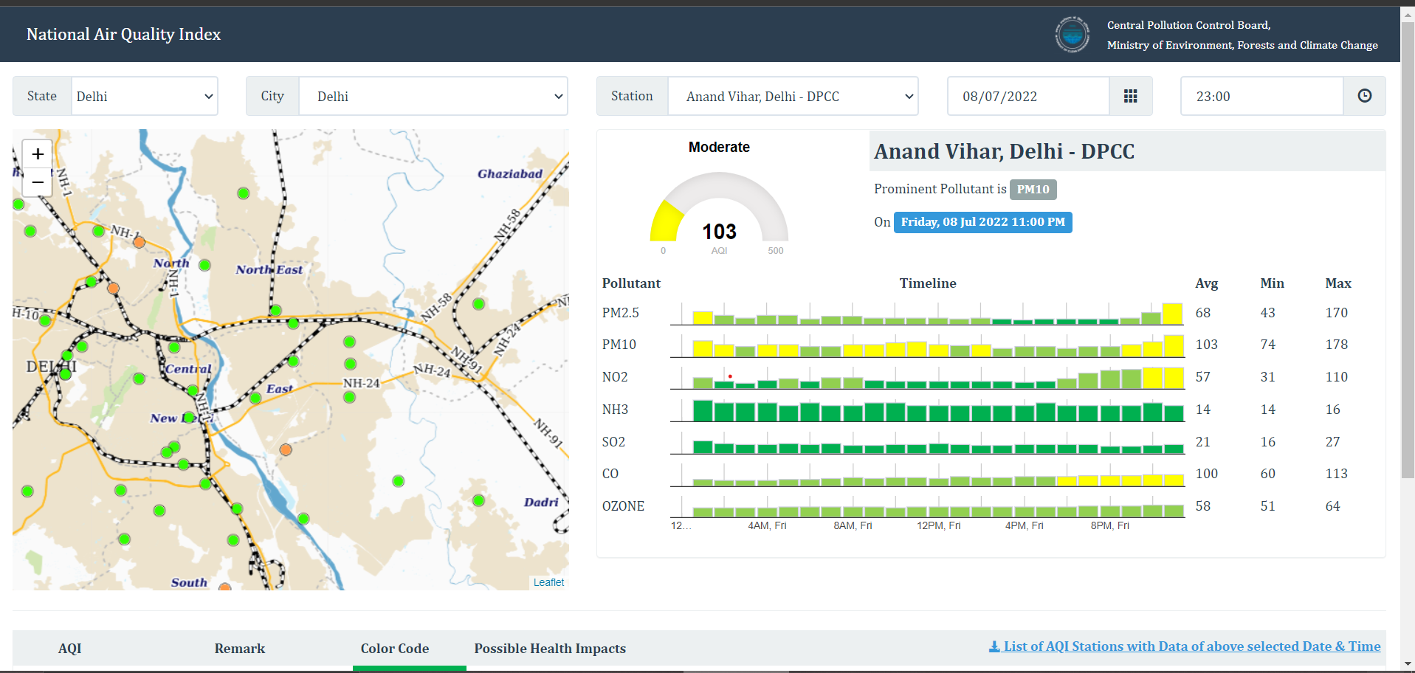
DATA COLLECTION
The data has collected Central Pollution Control Board (CPCB) of India it an organization under the Government of India responsible for Air and Water Quality Monitoring Services and any other pollution-related issues
The real time data has collected by this website of three cities Bhiwandi, Ghaziabad, Delhi from year 2019 to 26-June-2022

Slide 9
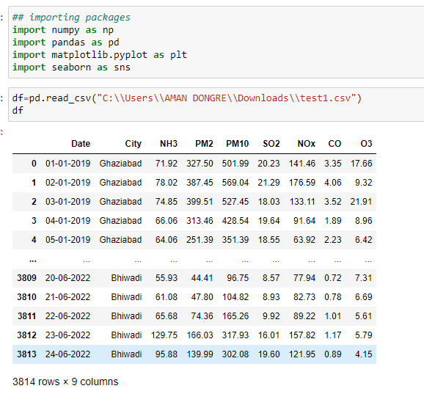
DATASET:
We have to calculate the sub_indexs of all the pollutant and AQI value and the AQI_bucket.

Slide 10
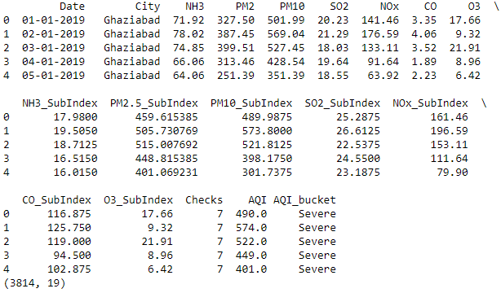
DATASET:
Before calculation of AQI and AQI_bucket Values the we were having the data shape as 3814 rows and 9 .
After calculation of sub_index of all pollutants , AQI and AQI_bucket dataset has

Slide 11
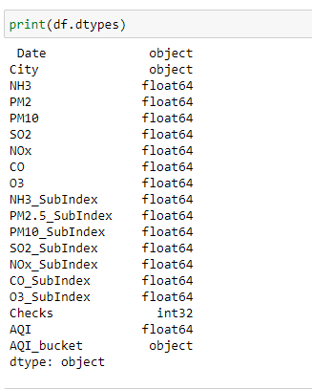
Dataset datatypes

Slide 12
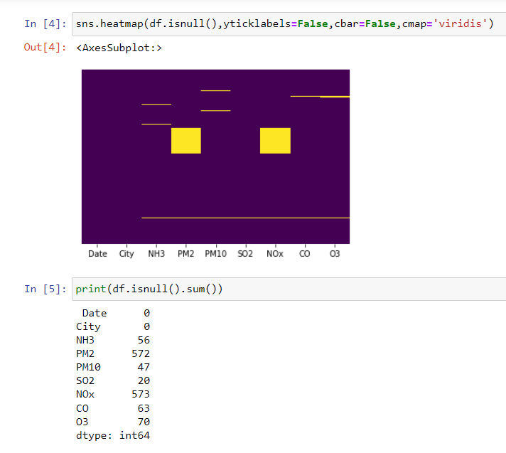
Finding the Null values:
isnull() method has been used which return the Bool values for each value in the dataframe that indicates whether an element is an NA value.
It gives the True for NA values otherwise it return the False if values is not value.

Slide 13
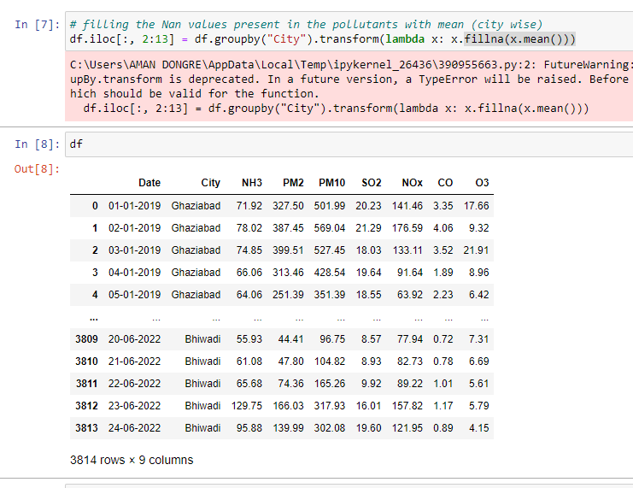
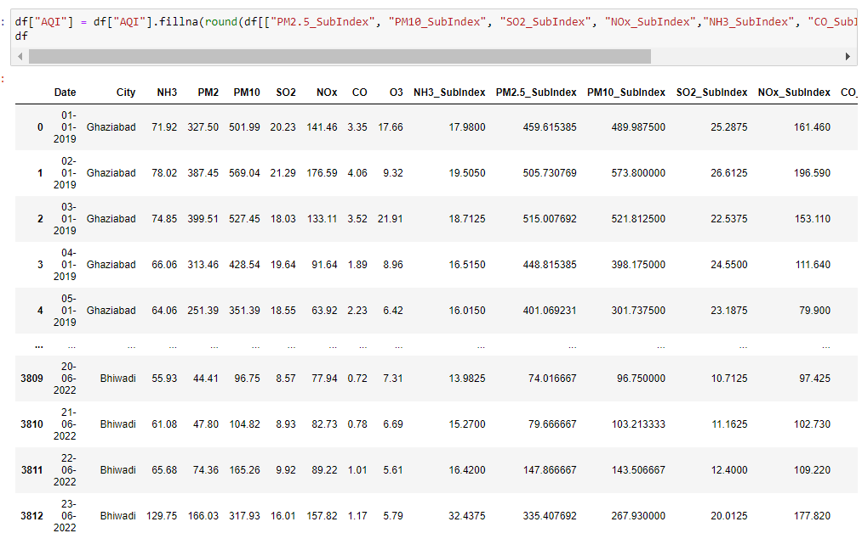
Handling Null values
Filling the null values of features
For fill null values of AQI we had use round of all subindex values.

Slide 14
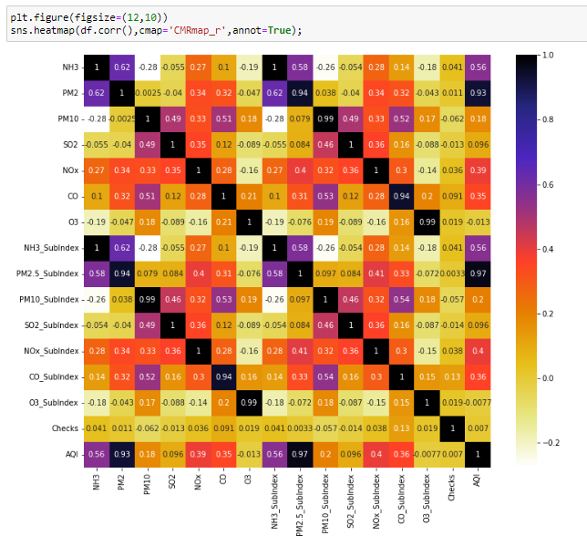
Correlation:
As we can observe that the pollutants value and Sub_indexs of the pollutants are highly correlated. So we can drop the sub_index of the pollutant otherwise there is higher change of having duplicates in the dataset we will also drop the checks column.

Slide 15
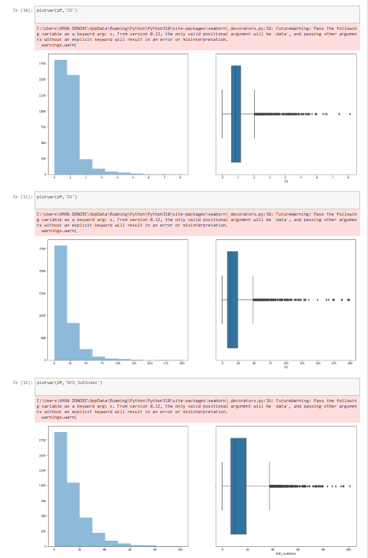
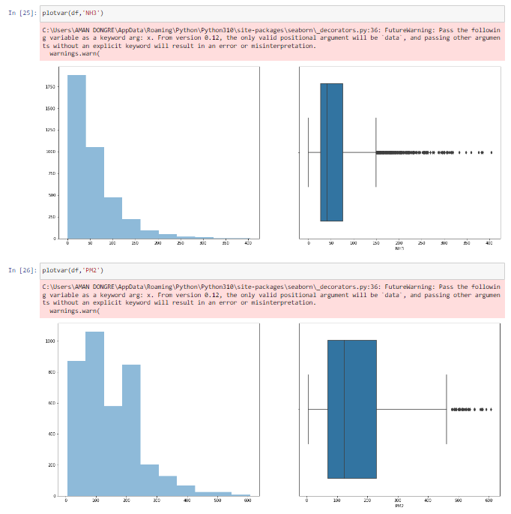
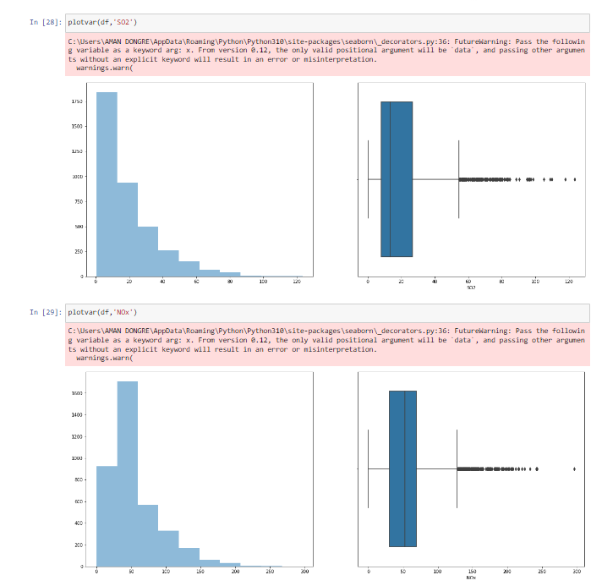
BOX plot and histogram:

Slide 16
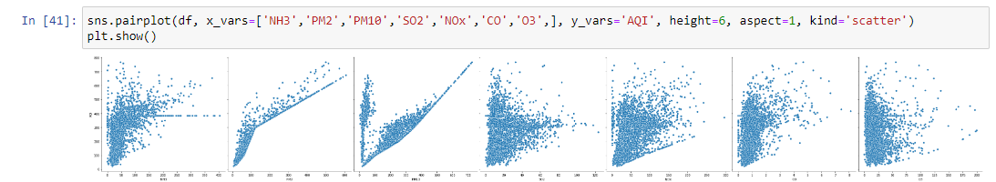
Scatter Plot:

Slide 17
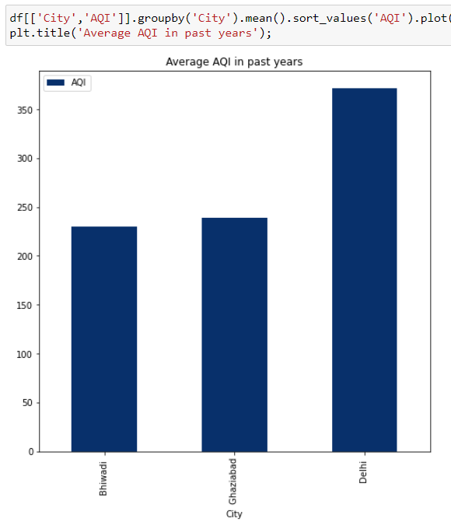
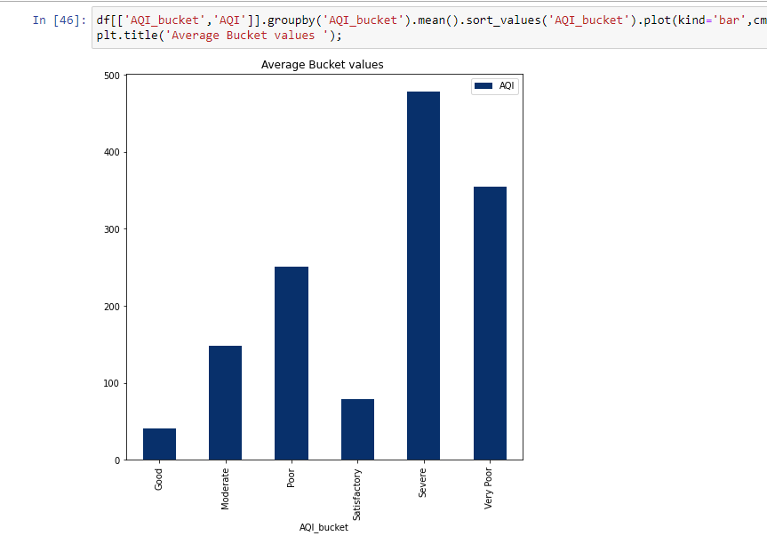
AVERAGE AQI OF CITY :

Slide 18
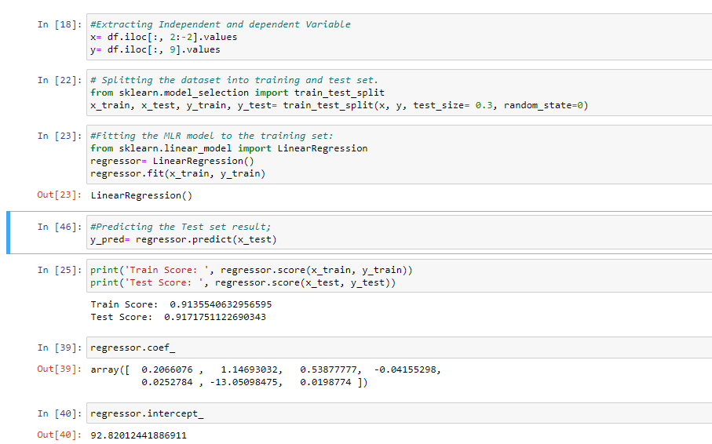
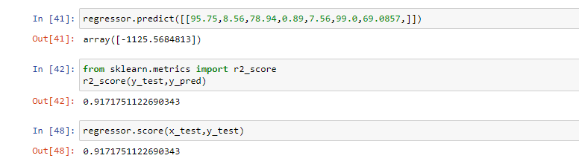
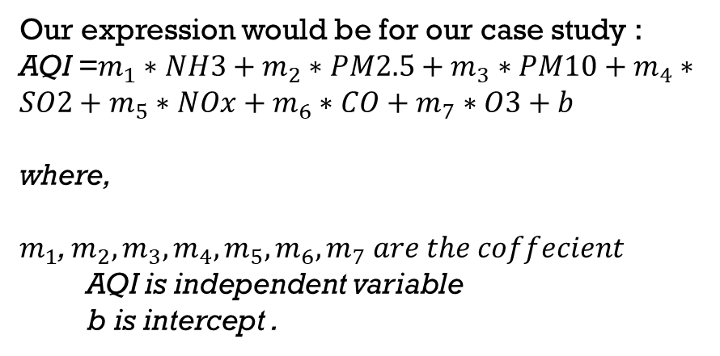
MULTIPLE LINEAR REGRESSION
Our expression would be for our case study :
AQI =$m_{1}∗NH3+m_{2}∗PM2.5+m_{3}∗PM10+m_{4}∗SO2+m_{5}∗NOx+m_{6}∗CO+m_{7}∗O3+b$
where,
$m_{1}$, $m_{2},m_{3},m_{4},m_{5},m_{6},m_{7} are the coffecient$
AQI is independent variable
b is intercept .

Slide 19
K-Nearest Neighbour(KNN)
K = 5
K-NN algorithm assumes the similarity between the new case/data and available cases and put the new case into the category that is most similar to the available categories.
K-NN algorithm stores all the available data and classifies a new data point based on the similarity.
How does k-NN work ?
Step – 1: Select the number K of the neighbors
Step – 2 Calculate the Euclidean distance of K number of neighbors
Step – 3 Take the K nearest neighbors as per the calculated Euclidean distance.
Step – 4 Among these k neighbors, count the number of the data points in each category.
Step – 5 Assign the new data points to that category for which the number of the neighbor is maximum.

Slide 20
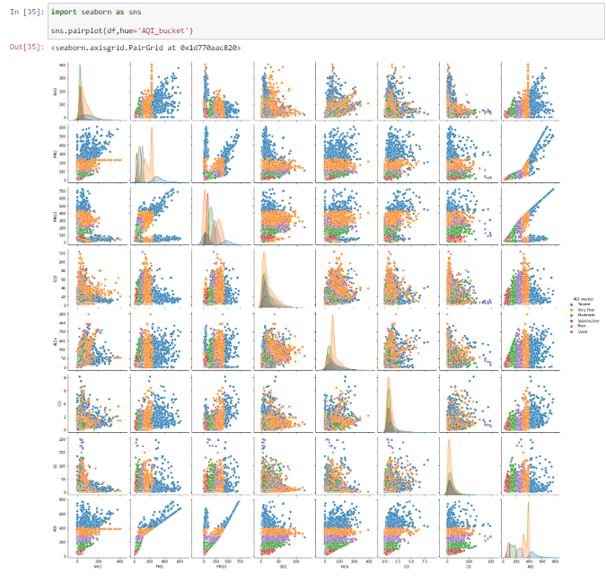
Pair plot:
We have to classify the AQI_bucket value
We can observe that we have 6 classes in our classification problem.
AQI_bucket classes :
Good Poor
Very poor
sever
satisfactory
sever

Slide 21
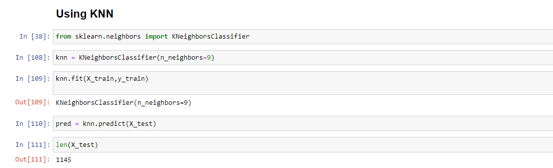
Implementation of model –
- feature Scaling :
Because the KNN classifier predicts the class of a given test observation by identifying the observations that are nearest to it, the scale of the variables matters. Any variables that are on a large scale will have a much larger effect on the distance between the observations, and hence on the KNN classifier, than variables that are on a small scale.
- Train test of the model:

Slide 22
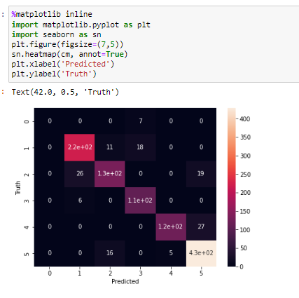
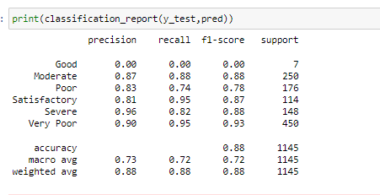
Classification report and confusion matrix

Slide 23



Support vector machine:
SVM is one of the most popular supervised learning algorithm which is used for classification as well as regression problems. However , primarily it is used for classification problems in machine learning.
SVM chooses the extreme vectors that help in creating the hyperplane. These extreme are called as support vector, and hence it is called support vector machine.
Hyperplane
Support vector
This should be maximum
margin

Slide 24
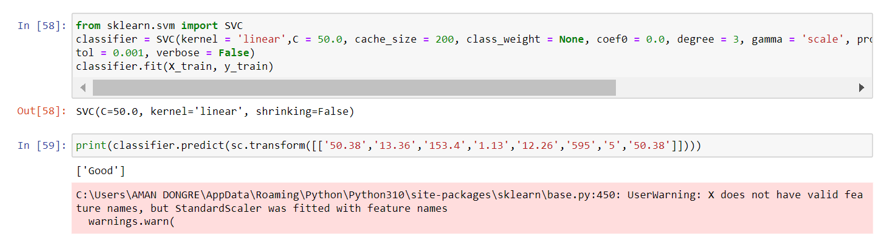
IMPLEMENTATION OF SVM MODEL:

Slide 25
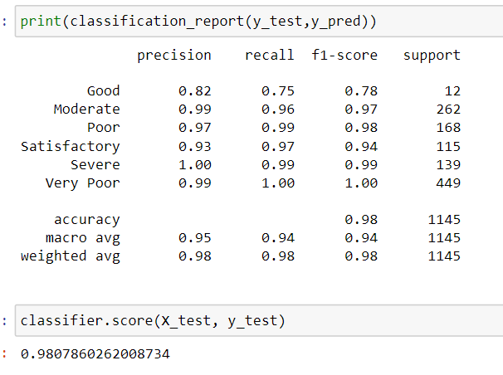
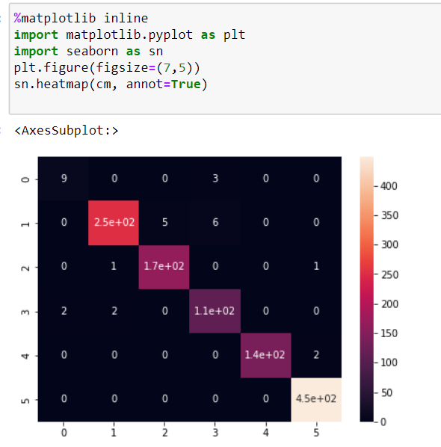
CONFUSION MATRIX AND CLASSIFICATION REPORT :

Slide 26
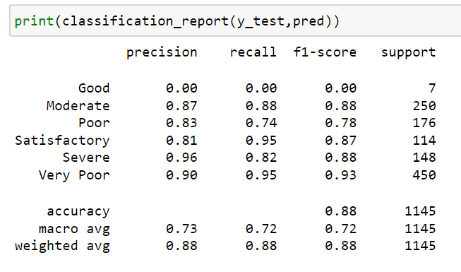
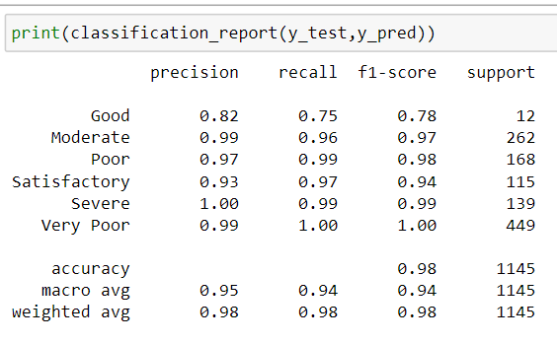
RESULT:
By performing the multiple linear regression, K nearest neighbor and Support vector machine we had observed precision, recall and f1- score of KNN algorithm is that much good as compared to the SVM model .

Slide 27
CONCLUSION
The study used the air quality data of three most polluted cities in India for past three years from Central Pollution Control Board , taking the the daily average concentration of seven major pollutants as characteristics factors, AQI as target factor and AQI_bucket as the classification target and multiple regression models that can predict the air quality index. Comparing the classification models according to the Support vector machine algorithm was more suitable for air quality index perdition, and SVM model has advantage that it is more predictive in high dimensional spaces, and high accuracy. further in improving the model by obtaining more data, deleting or correcting the input of inconsistent distribution or other methods

Slide 28
References:
Patel, D. (n.d.). youtube. Retrieved from https://www.youtube.com/watch?v=CQveSaMyEwM&t=762s
Naik, K. (n.d.). youtube . Retrieved from https://www.youtube.com/watch?v=H9yACitf-KM
Bhattacharya, Samayan, and Sk Shahnawaz. n.d. "Using Machine Learning to Predict Air Quality." Jadavpur.
R, Dr.Senthil Kumar, Dr.Anidha Arulanandham, Dr.Suresh Arumugam, Dr. Dinesh G, Dr.Thirukkumaran R, and Dr.Subashmoorthy R. n.d. Analysis of classification and clustering techniques. Marathalli, Bengaluru: IEEE Xplore.
Li, Chenchen, Yubin Bao, and LI Yan. 2021 . Reserch on Air Quality prediction based on Machine Learning . Reserch, Shenyang, China : IEEE xpolre

Slide 29
THANKYOU

